Slide 1




Mr. and Ms. APC
APC Week 2018

Slide 2
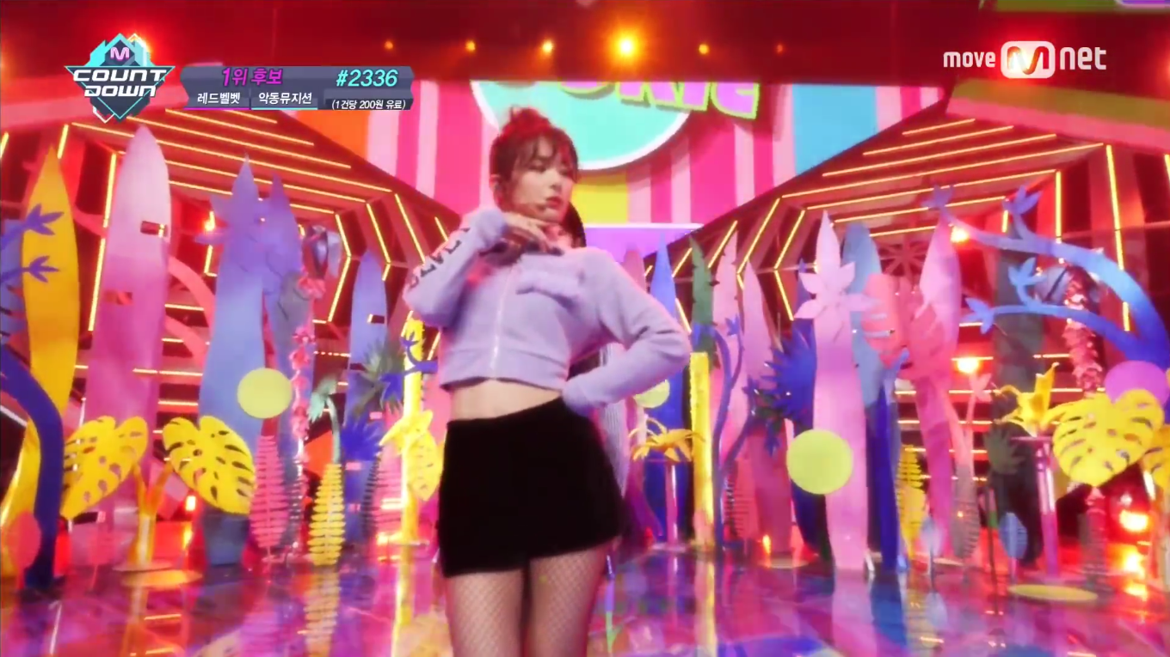

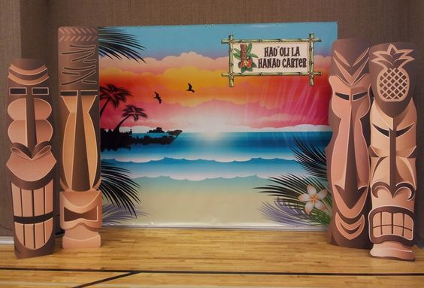
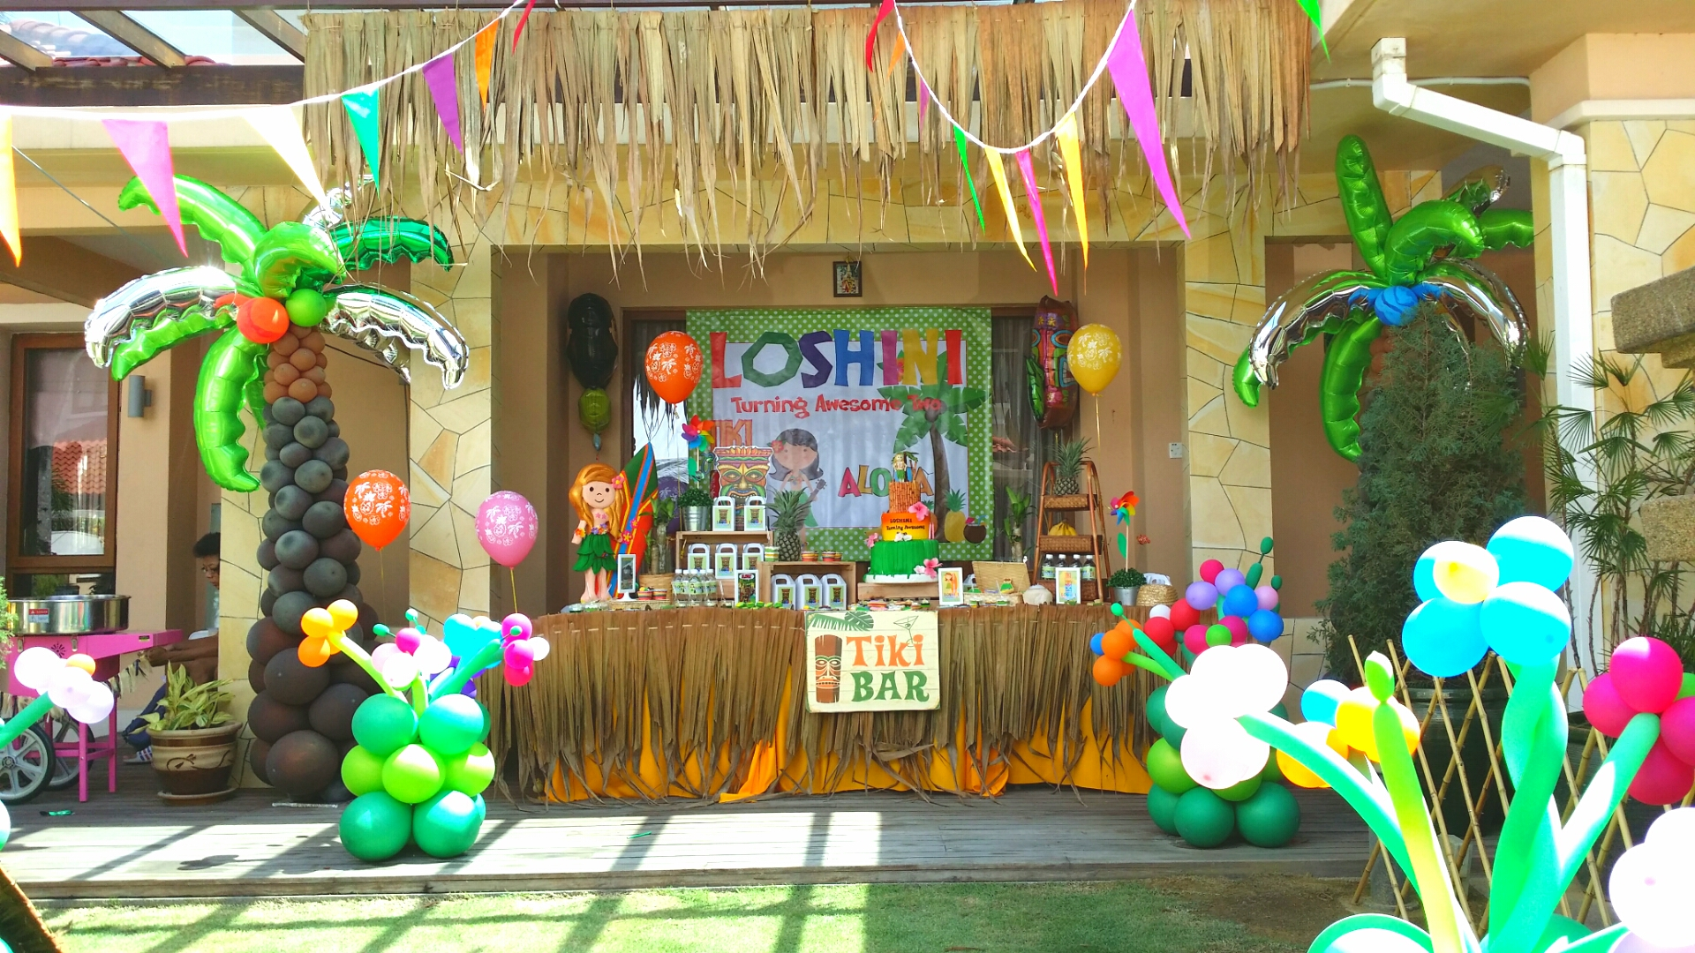
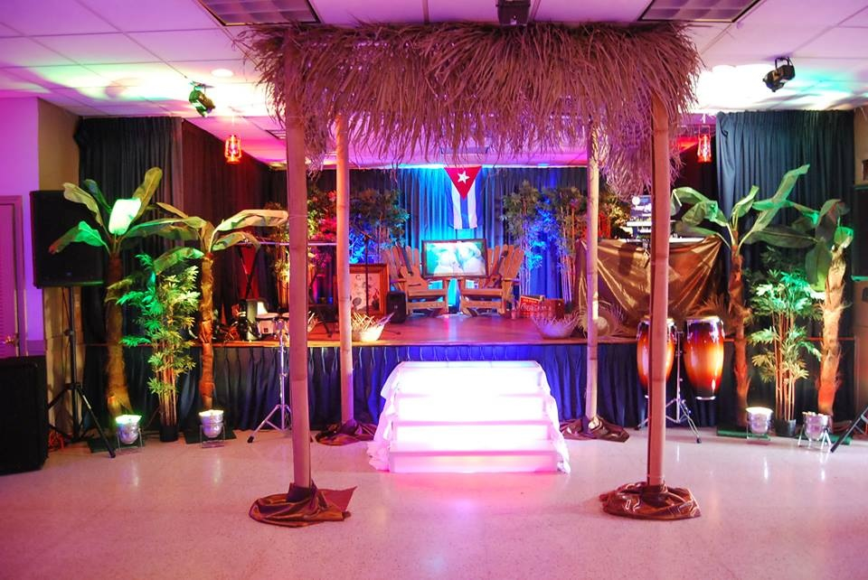
Mr. and Ms. APC
Notes:
Funding for this is already placed in the previous MoTM
Plot the schedule (starting screening → actual pageant)

Slide 3
Mr. and Ms. APC Committees
Mr. and Ms. APC
Stage Design
Technical Committee
Lights and Sound
Projectors
Tabulation
Creatives Committee
Documentation
Photoshoot
Stage Design
Ushers Committee
Registration
House
Escorts
Backstage Committee
Rehearsals
Program Flow
Dressing Room
Notes:
This will be the stage design… Feel free to suggest others (look for some pictures and include them in the appendix pat of the MoTM

Slide 4
Mr. and Ms. APC Committees
Technical Committee
Lights and Sound
Projectors
Tabulation
Creatives Committee
Documentation
Photoshoot
Stage Design
Ushers Committee
Registration
House
Escorts
Backstage Committee
Rehearsals
Program Flow
Dressing Room
Notes:
Assign orgs for these committees (as well as the sub-committees)
-- add more committees if needed (or alter them)
As much as possible, divide them equally per school (see the Org-List.docx)
Ushers Committee
House → Maintain order inside the auditorium
Escorts → For external visitors (Relatives of contestants)
Registration

Slide 5

Mr. and Ms. APC Committees
Technical Committee
Lights and Sound
Projectors
Tabulation
Creatives Committee
Documentation
Photoshoot
Stage Design
Ushers Committee
Registration
House
Escorts
Backstage Committee
Rehearsals
Program Flow
Dressing Room
RAMS Night
RAMS Night Committees
Technical Committee
Lights and Sound
Creatives Committee
Photo booth
Stage Design
Ushers Committee
Registration
House
Escorts
Performers
PAG
APC Idol Winner
Booths
Games
Food
Backstage Committee
Registration
House
Escorts
Notes:
Fundings for this is already included in the previous MoTM
Reiterate that the stage design for the Pageant will be recycled for the Rams Night
Fix the program flow for this (We have an existing one in one of the previous MoTMs)
Miss Hanna may link the Vibrant Music Fest here…. See slide 17

Slide 6

RAMS Night Committees
Technical Committee
Lights and Sound
Creatives Committee
Photo booth
Stage Design
Ushers Committee
Registration
House
Escorts
Performers
PAG
APC Idol Winner
Booths
Games
Food
Backstage Committee
Registration
House
Escorts
Notes:
Ushers Committee
House → Maintain order inside the auditorium
Escorts → For external visitors (Relatives of contestants)
Registration

Slide 7

MINI-MERCATO
Notes:
Look for more concessionares → To be presented tomorrow (APC Week Committee Meeting)
We still lack desert concessionares… What are the bestsellers during the SHS entrep fair??

Slide 8
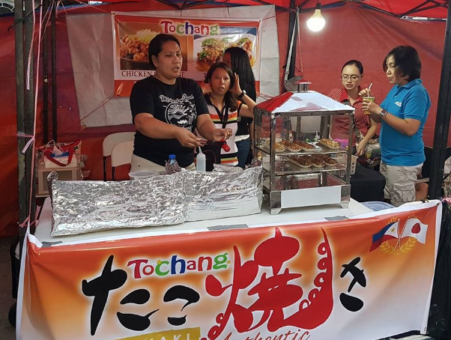
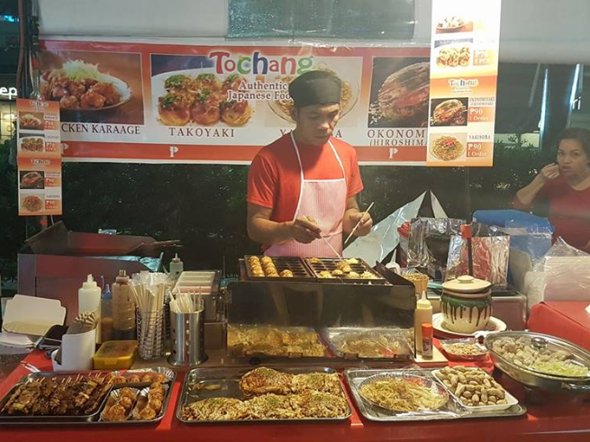
Totchang Authentic Japanese Food
Cuisine | Japanese Food
Menu | Takoyaki, Okonomiyaki, Yakisoba, Chicken Karaage, etc.
Price Range | ₱ 50.00 – ₱ 160.00
Notes | Has several outlets; scouted in Bluebay Walk Have been in Asia Pacific College during the SoCIT Fest 2017
Contact | Facebook Profile: https://www.facebook.com/Totchang.japan/

Slide 9
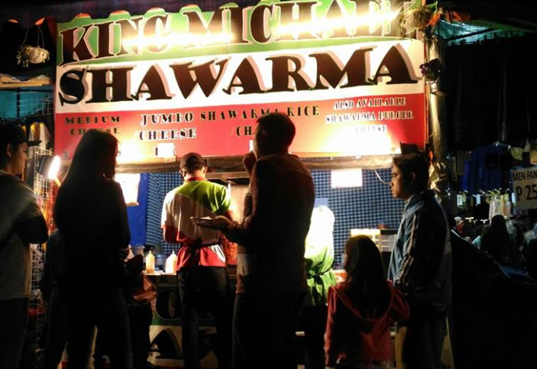
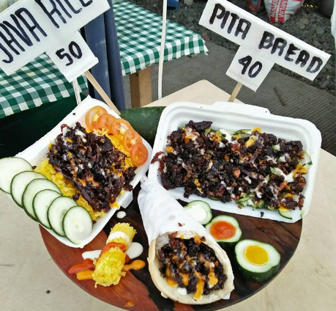
KING Michael Shawarma
Cuisine | Shawarma Meals
Menu | Shawarma and Shawarma Rice
Price Range | ₱ 40.00 – ₱ 70.00
Notes | Has several outlets, and participates in Food Bazaars
Contact | Facebook Profile: https://www.facebook.com/KING-Michael-Shawarma-400149566986778/?ref=py_c

Slide 10
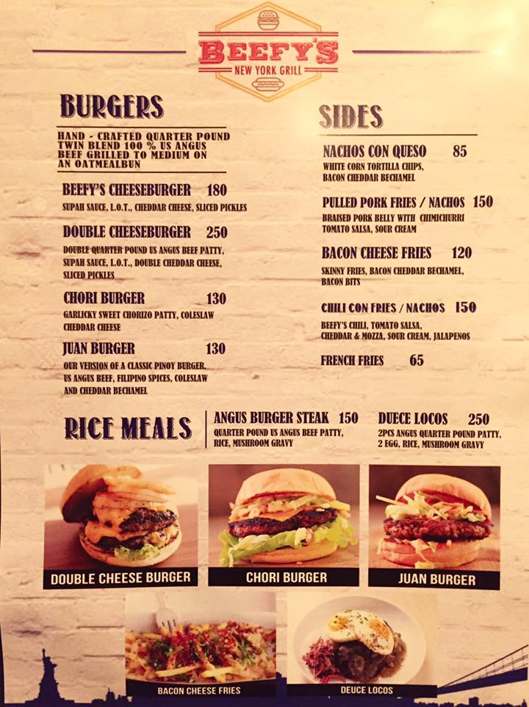
Beefy’s New York Grill
Cuisine | Mexican Cuisine
Menu | Cheeseburgers, Fries, Nachos, Rice Meals, etc.
Price Range | ₱ 65.00 – ₱ 250.00
Notes | Has an outlet in The Pantree
Contact | Facebook Profile https://www.facebook.com/Beefys-New-York-Grill-1830853233804152/ Mobile Number 09398997524

Slide 11
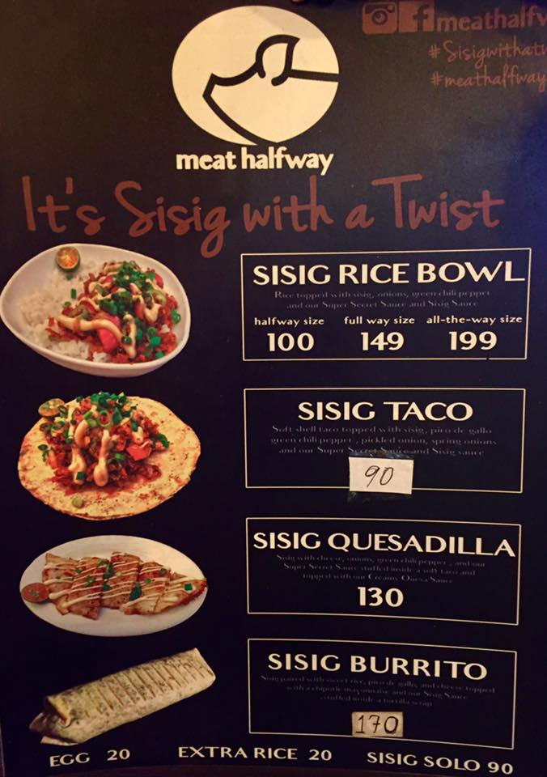
Meat Halfway
Cuisine | Mexican Cuisine
Menu | Sisir Rice Bowl, Burrito, Taco, Quesadilla
Price Range | ₱ 90.00 – ₱ 199.00
Notes | Scouted in The Pantree
Contact | Facebook Profile: https://www.facebook.com/meathalfway/ Contact Number: 0926 074 6486

Slide 12
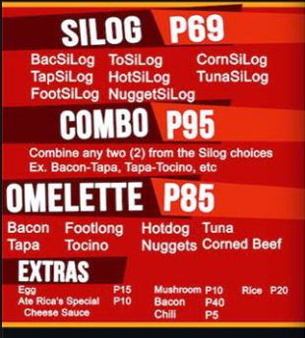
Ate Rica’s BacSiLog
Cuisine | SILOG-Meals
Menu | Bacon-Sinaing-Itlog, and other SiLog varieties
Price Range | ₱ 69.00 – ₱ 95.00
Notes | Target Customers: Students (has outlets in UMAK, DLSU, UST, etc.) and Young Professionals (St. Francis Square) In easy-to-carry containers
Contact | Facebook Profile https://www.facebook.com/AteRicasBacsilog/ Contact Number 09173085744

Slide 13
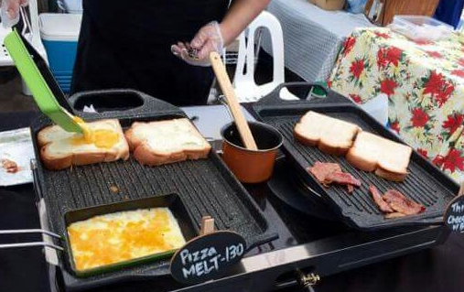
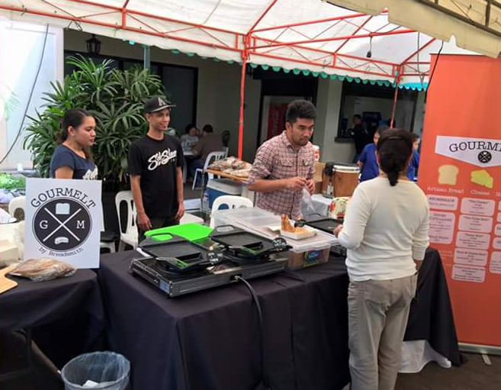
Gourmelt
Cuisine | Snacks (Grilled Cheese Sandwiches)
Menu | Pizza Melt, Texas Melt, Classic, etc.
Price Range | ₱ 120.00 – ₱ 190.00
Notes | Participated in the BGC Night Market Participated in FEU Dilimans Institutional Week
Contact | Facebook Profile: https://www.facebook.com/pg/gourmeltph/

Slide 14
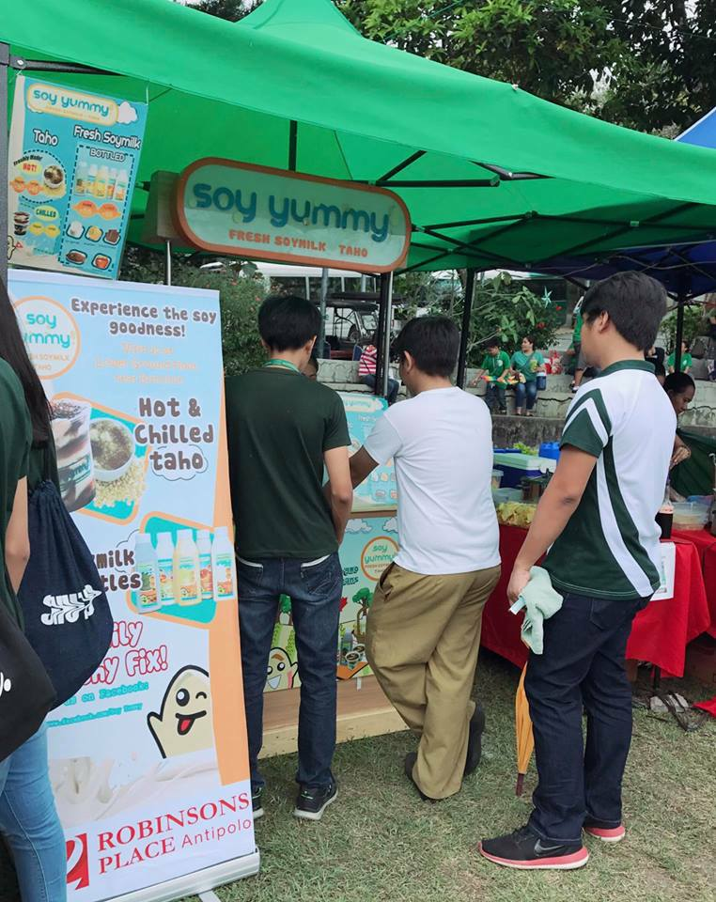
Soy Yummy
Cuisine | Beverage and Snacks
Menu | Chilled Taho, Fresh Soymilk, Taho Milktea
Price Range | ₱ 30.00 – ₱ 95.00
Notes | They have mall outlets Recently joined Lasalle Antipolo’s School Fair
Contact | Facebook Profile: https://www.facebook.com/Soy.Yummy/ Contact Number: (02) 522 4934

Slide 15
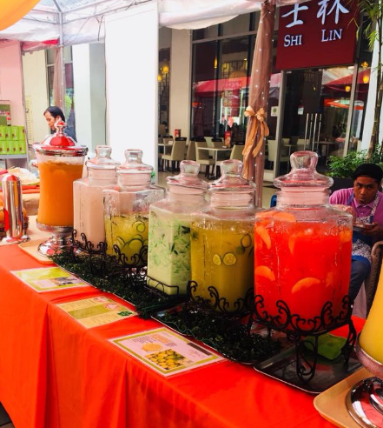
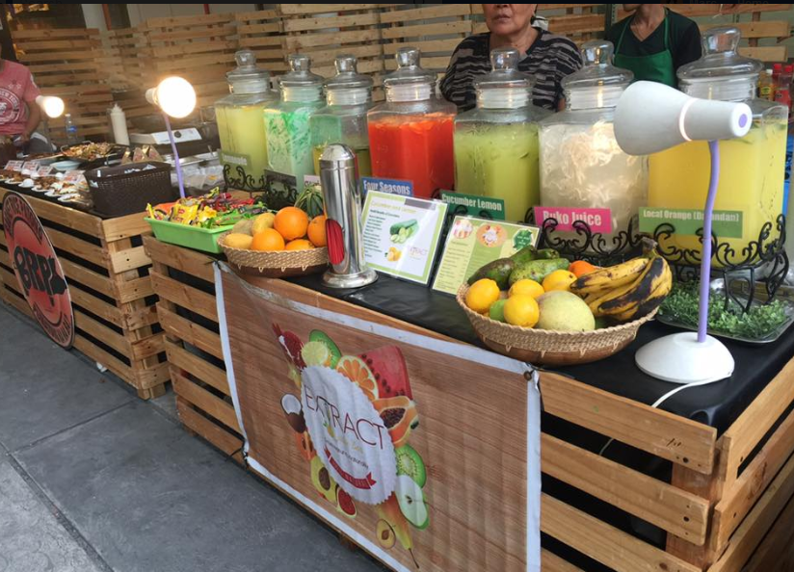
Extract Juice Bar Manila
Cuisine | Fruit Juices/Beverages
Menu | Buko Juice, Cucumber Lemon, etc. Also offers Fruit Shakes
Price Range | ₱ 50.00 – ₱ 70.00
Notes | Has foodpark outlets (Localle Foodpark, Bite Me Manila, etc)
Contact | Facebook Profile: https://www.facebook.com/ExtractJuiceBarManila/ Mobile Number: 0917 591 2122

Slide 16
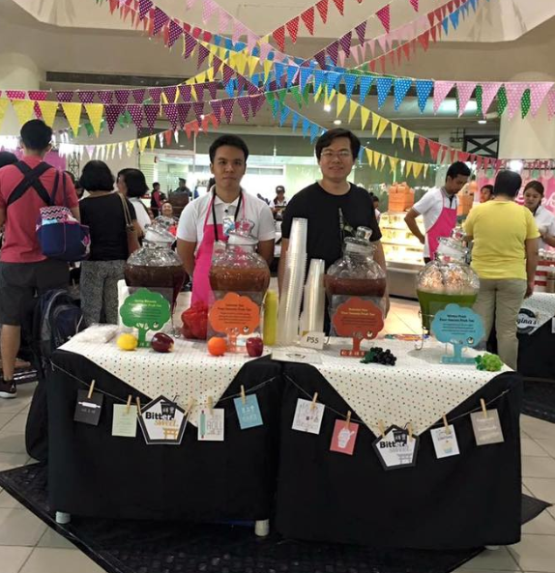
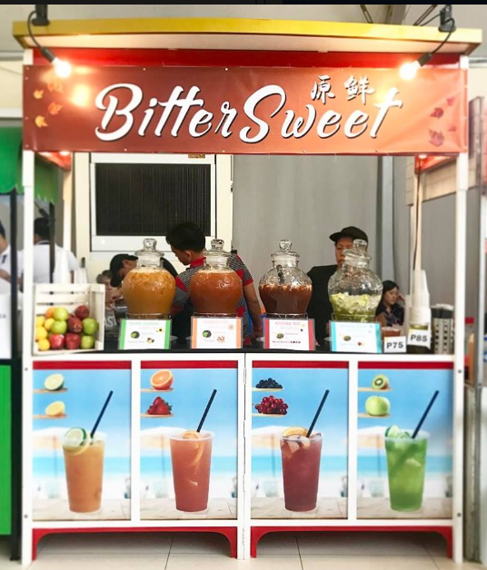

Vibrant Music Fest
BitterSweet Fruit Tea
Cuisine | Fruit Teas
Menu | Black Ceylon Tea, Winter Frost, Autumn Hue, etc.
Price Range | ₱ 55.00 – ₱ 120.00
Notes | Has several Mall Outlets Participates in Bazaars (Trendsetter, Manila Sundance, etc)
Contact | Facebook Profile: https://www.facebook.com/bittersweetfruittea/ Mobile Number: 09177982731

Slide 17
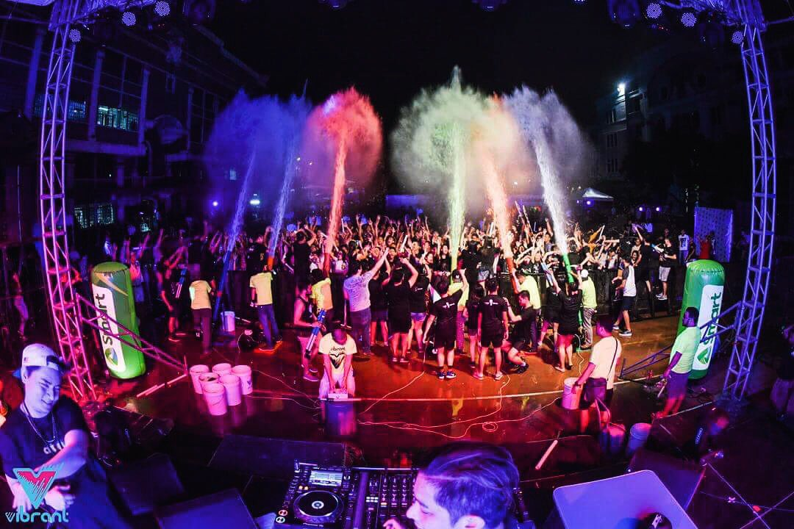

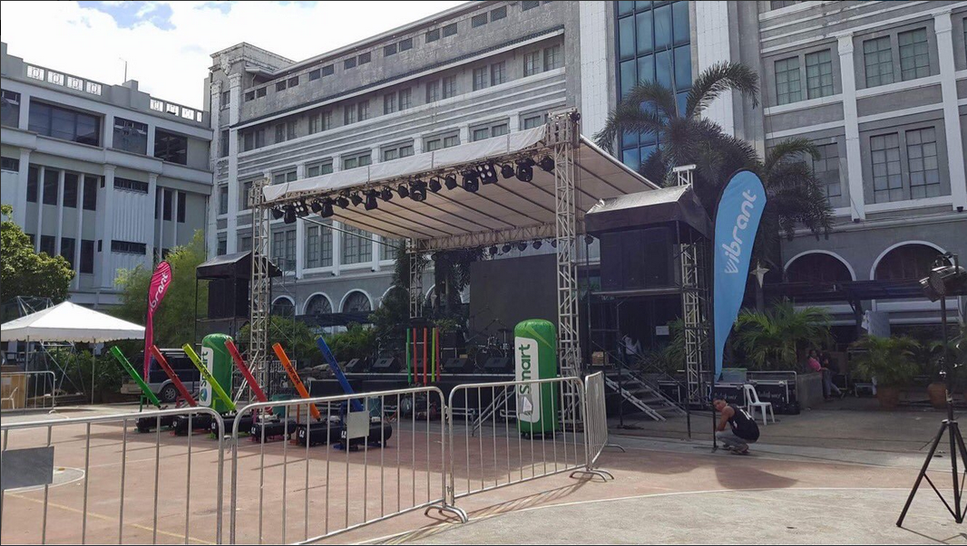


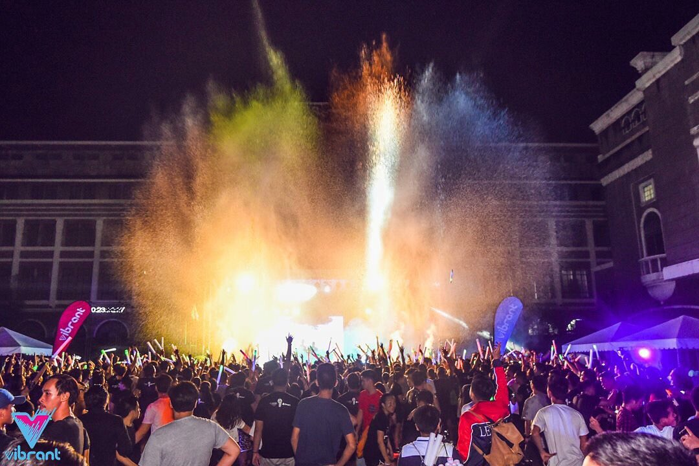
Vibrant Music Fest
Notes:
(c/o Miss Hanna)

Slide 18
Vibrant Music Fest
Notes:
Recently, Vibrant Music Fest participated and ended Letrans Colegio Week (Arriba Fest)
(( see sponsors below the poster; Pony, Smart)) is it possible if we can also invite them over?

